Slide 1
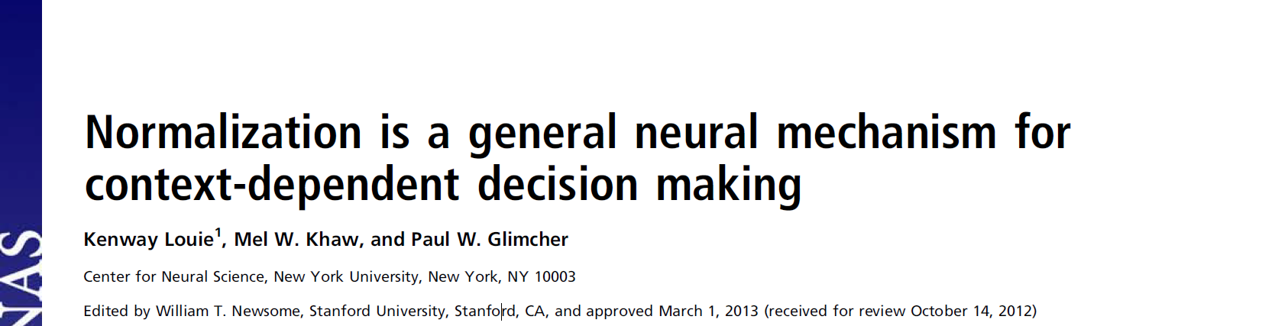
心理与认知科学学院 陈健柏 程宇昂

Slide 2
Introduction(Goal)
Independence of irrelevant alternatives & Context-dependent choice behavior
Previous models typically rely on higher cognitive process like attentional switching between dimensions, differential weighting of attributes…
A model based on divisive normalization

Slide 3
Introduction(Inspiration)
Divisive normalization
Initial input-driven activity of a neuron is divided by the summed activity of a large pool of neighboring neurons
Originally proposed in V1 to explain extrareceptive field stimuli
Recently found in value representation of actions
How to go from context-dependent neural activity to choice behavior?

Slide 4
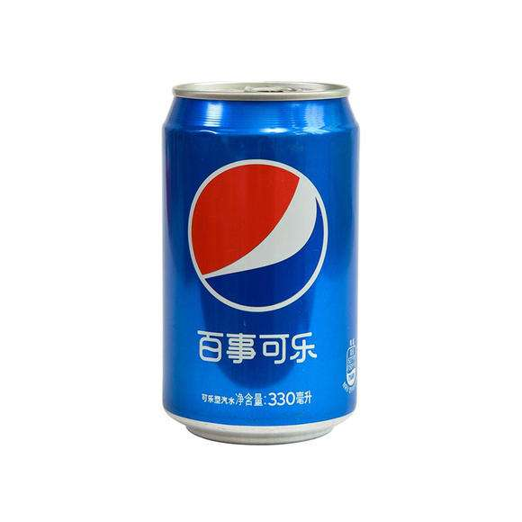
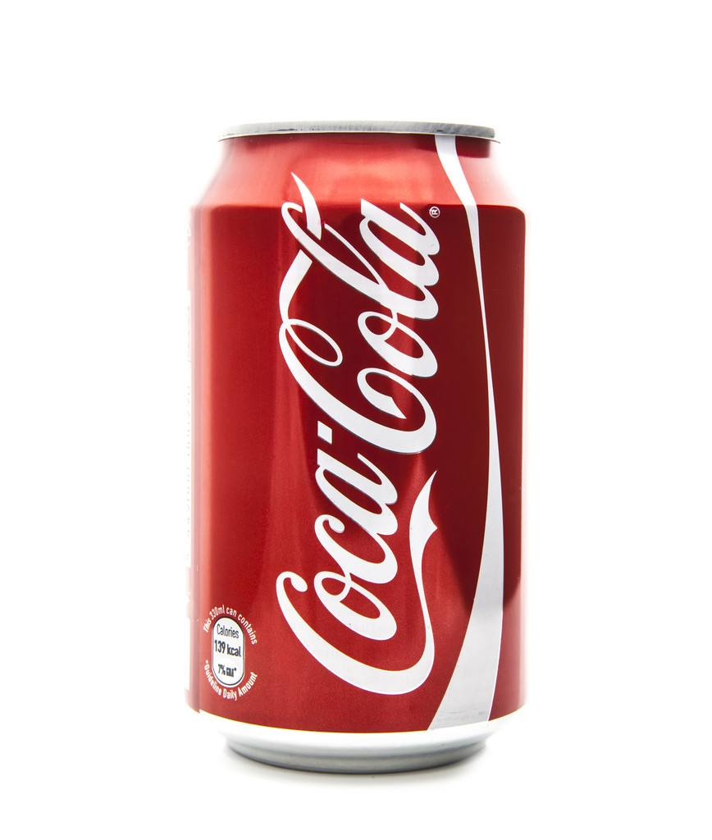
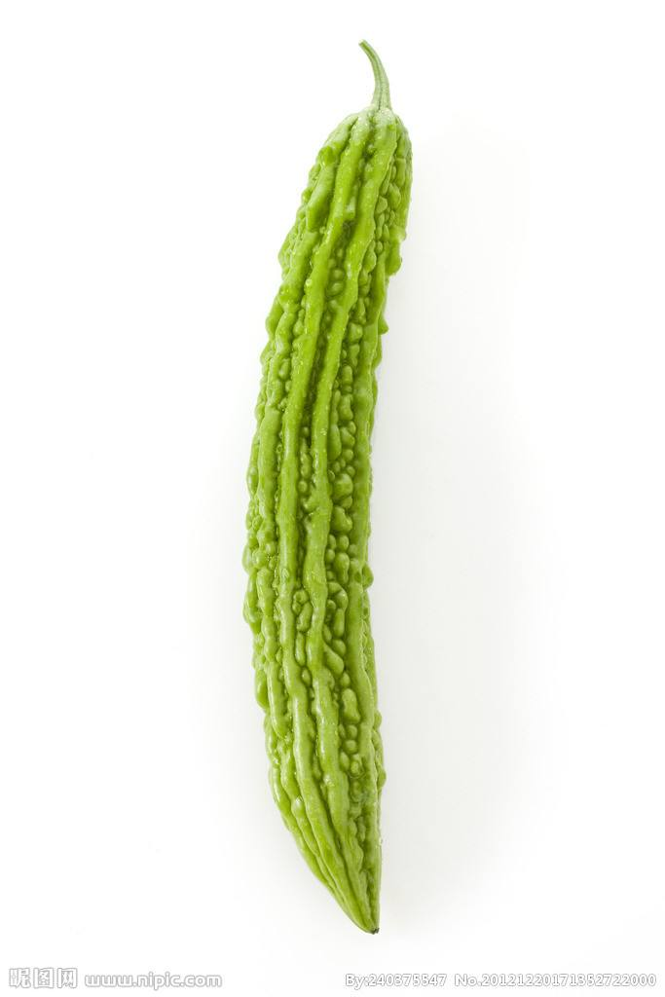
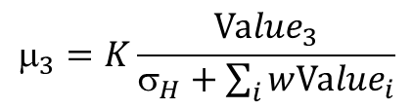

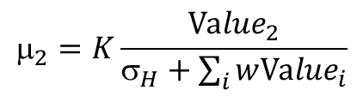

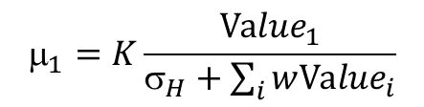

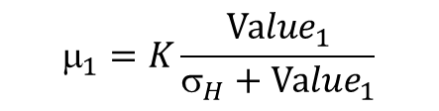
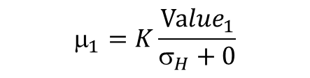
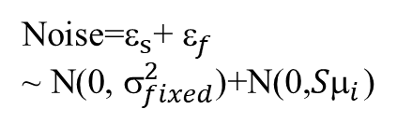
Model
$$_{1}=K\frac{{Value}_{1}}{σ_{H}+0}$$
Absolute model:
w=0
$$_{1}=K\frac{{Value}_{1}}{σ_{H}+\sum_{i}{w{Value}_{i}}}$$
+
Value 1
$$_{1}=K_{a}×{Value}_{1}$$
$$_{1}=K\frac{{Value}_{1}}{σ_{H}+{Value}_{1}}$$
w=1,i=1
$$_{2}=K\frac{{Value}_{2}}{σ_{H}+\sum_{i}{w{Value}_{i}}}$$
+
Argmax
Value 2
$$_{2}=K_{a}×{Value}_{2}$$
$$_{3}=K\frac{{Value}_{3}}{σ_{H}+\sum_{i}{w{Value}_{i}}}$$
+
Value 3
$$_{3}=K_{a}×{Value}_{3}$$
Average firing rate
Noise=$_{s}$+ $_{f}$
~ N(0, $_{fixed}^{2}$)+N(0,${S}_{i}$)

Slide 5
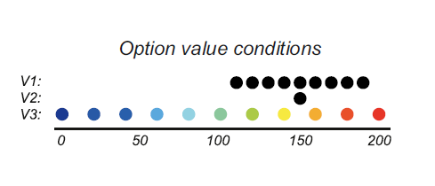
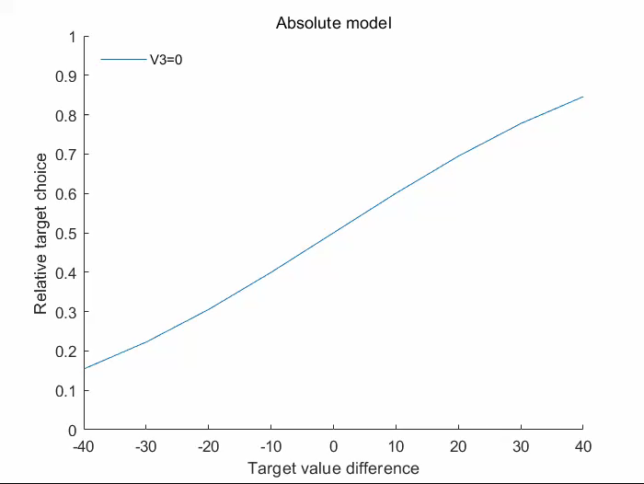
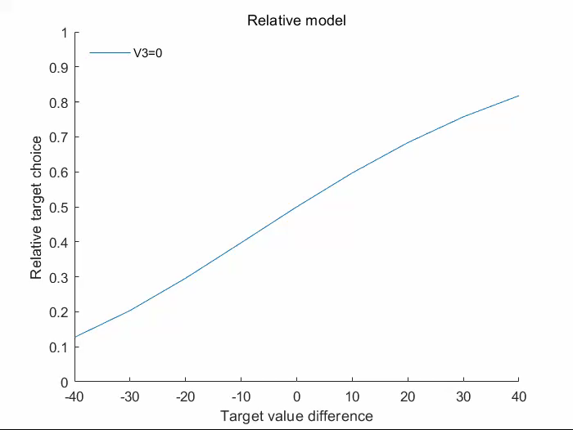
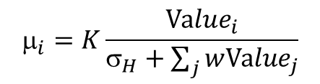

Model Predictions
$$_{i}=K\frac{{Value}_{i}}{σ_{H}+\sum_{j}{w{Value}_{j}}}$$
$Relative target choice=\frac{p_{1}}{p_{1}+p_{2}}$
Notes:
在之后的ppt中，我们有时候也会将V3称为distractor

Slide 6
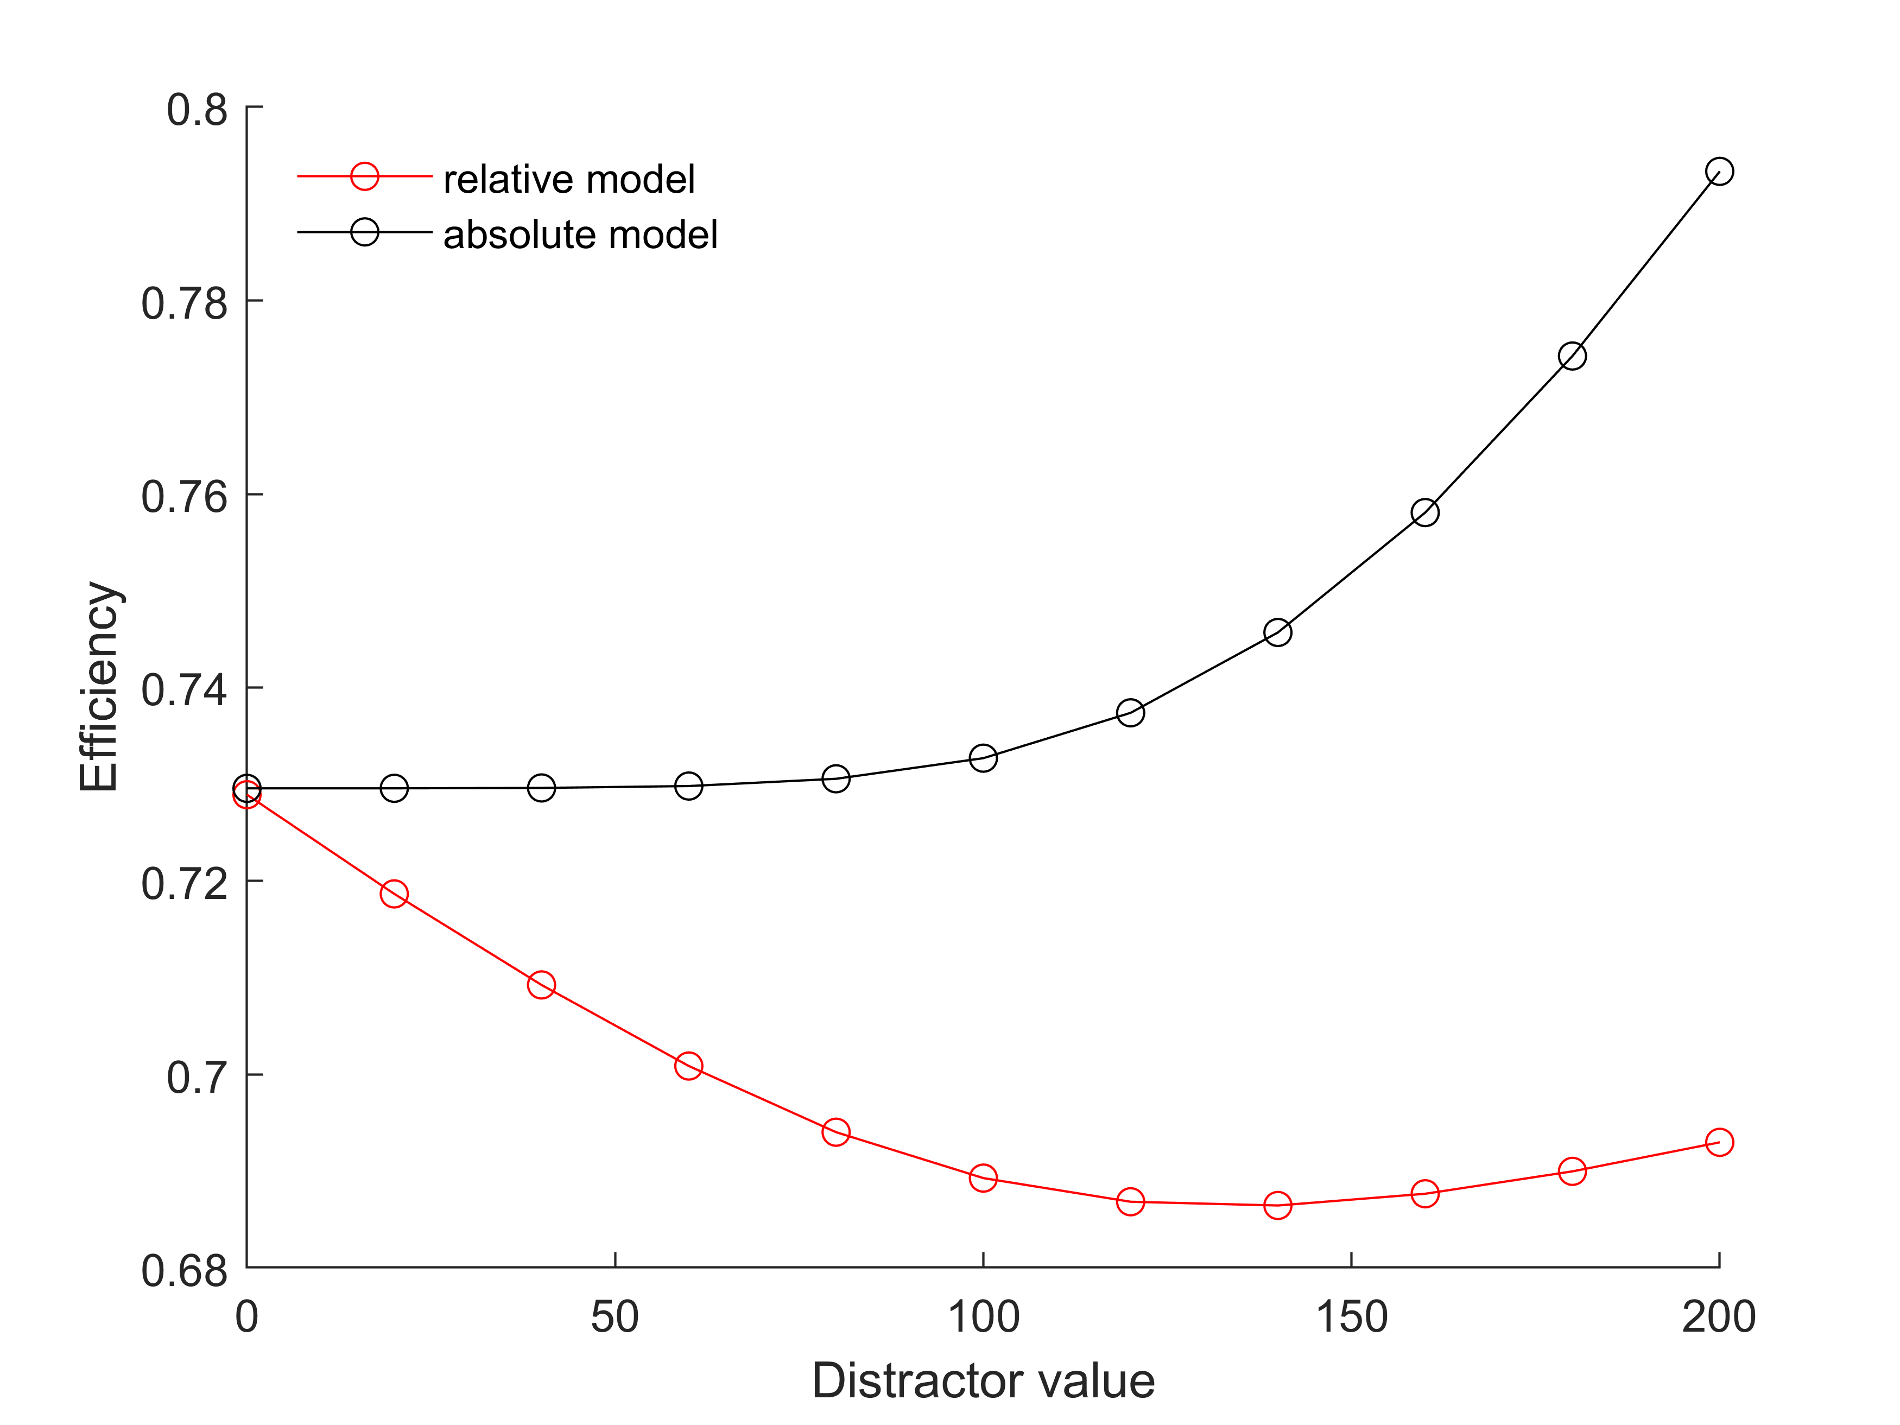
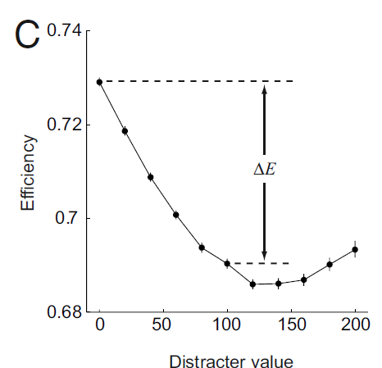

Model Predictions
$$_{i}=K\frac{{Value}_{i}}{σ_{H}+\sum_{j}{w{Value}_{j}}}$$
$Efficiency=\frac{p_{better}}{p_{1}+p_{2}}$
$∆E=Efficiency\left(0\right)−Efficiency(100)$
Notes:
在之后的ppt中，我们有时候也会将V3称为distractor

Slide 7
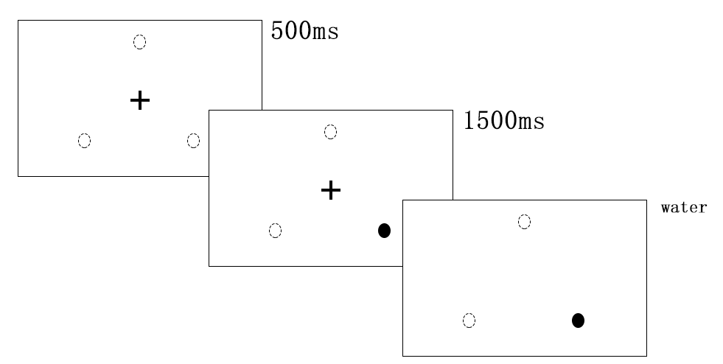
Monkey Trinary-Choice Experiment
Subjects: 2 male rhesus monkeys(monkey W, ∼6.0 kg; monkey B, ∼14.0 kg)
Reward: water
V1 = {130, 143, 156, 169, 182}
V2 = 156
V3 = {26, 104} (microliters)
Procedure(one block):
40 instructed trials
15~30 choice trials

Slide 8
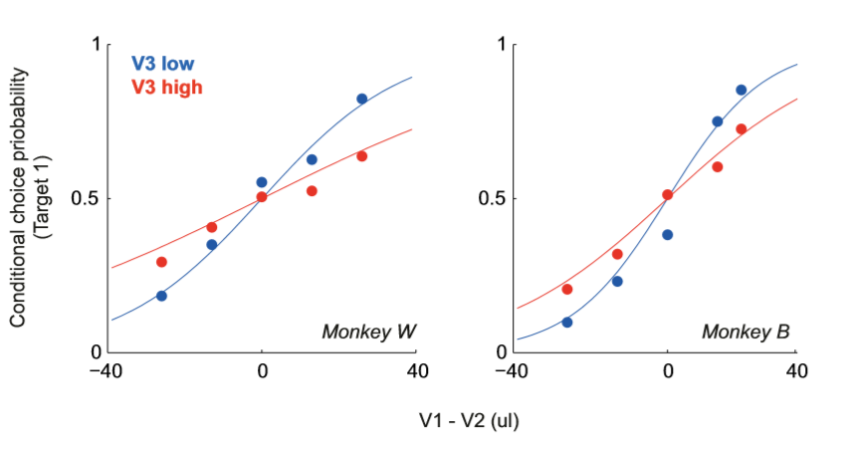

Monkey Trinary-Choice Experiment
Result:
$p_{high}=69.3\%, p_{low}=27.0\%, p_{distracter}=3.7\%$
V3 low->V3 high: 84.4% -> 69.1%

Slide 9
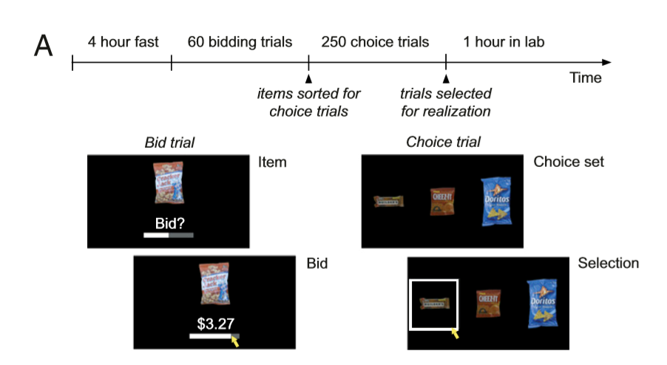
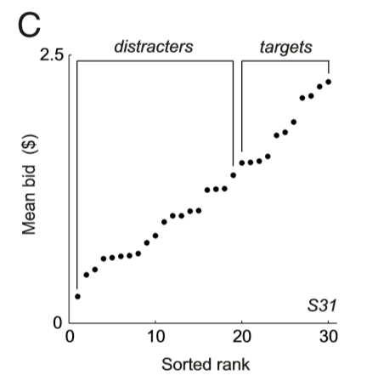
Human Trinary-Choice Experiment
Subjects: n=43(21 female, 18-43y)
Procedure:
fast for 4 h
60 bid trials
30 different food items
an image of a snack-food item on a computer
0$-4$ in 0.01$increments
300 choice trials
Trinary-Choice
Realization-one of the 360 trials
Bid trials: Becker–DeGroot–Marschak aution
Choice trials: receive the food

Slide 10

Human Trinary-Choice Experiment
Results(choice trials):
$p_{high}=60.5\%, p_{low}=33.3\%, p_{distracter}=6.2\%$
$normV3=\frac{V3}{mean(V1,V2)}$
Decrease in choice efficient
Biphasic response at high distracter value

Slide 11
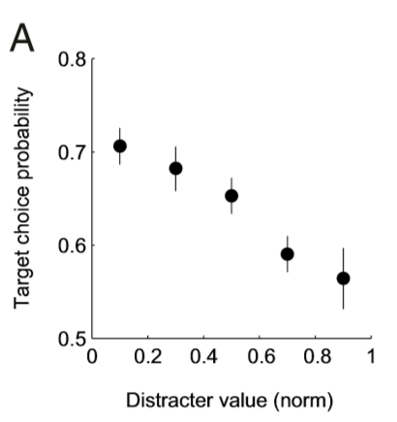
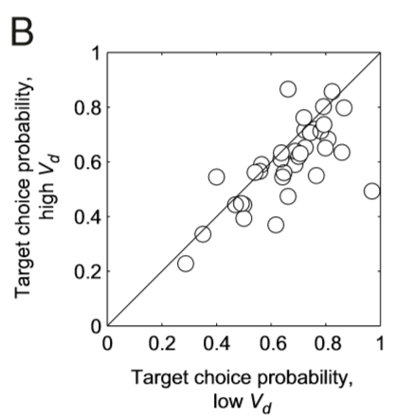

Human Trinary-Choice Experiment
Results(choice trials):
Decrease in choice efficient
Linear regression:
$η=β_{0}+β_{1}V_{1}+β_{2}V_{2}+β_{3}normV_{3}$
$β_{1}=0.88, P\text{=1.2∗10^−52; }β_{2}=−1.01,P=4\text{.5∗10^−58; }β_{3}=−0.42, P=2\text{.1∗10^−7 }$
r = −0.80, P = 0.006
mean difference in target choice 0.064,P = 0.0019, t test

Slide 12
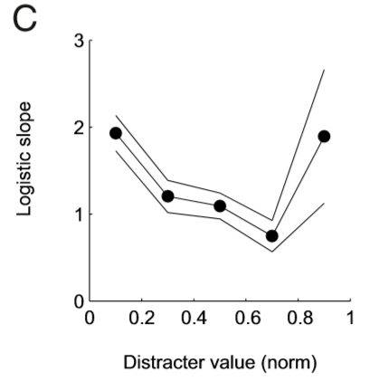
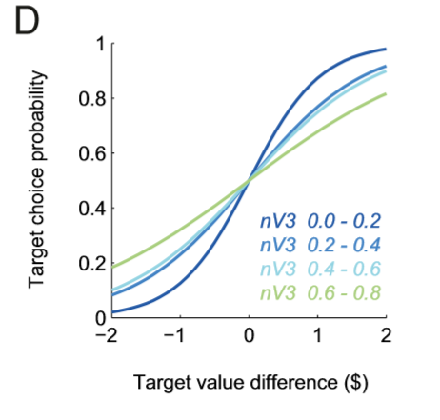
Human Trinary-Choice Experiment
Results(choice trials):
Biphasic response at high distracter value
Logistic regression

Slide 13

Human Trinary-Choice Experiment
Results(choice trials):
Biphasic response at high distracter value
Linear regression
$β_{3}=−0.54, P=\text{1.2∗10^−8}(normV_{3}<0.8)$
$β_{3}=0.42, P=0.001\left(normV_{3}>0.8\right)$
choose distractor
Low:4.3%
High:20%

Slide 14
Limitations
Model fittings are based on logistic or linear models, nothing on his own model.
Based on neurophysiology findings but no parameter values come from neurophysiology data.
Limited neural meanings about parameters setting.

